Slide 1
2021
Taxpayer
Satisfaction
Survey

Slide 2
Survey profile
Response rate declined 5.68 percentage points from 7.9% last year to 2.2%
Total number of responses 444 of 20,000 invitations
Criteria used for pulling the sample of taxpayers:
Either a monthly, quarterly, or annual filing frequency.
Tax accounts were open.
Tax account type was excise.
A return had been filed in the last 365 days.
Four cohorts:
 | 1 business/account | 2+ businesses/account
<= Median Gross Income | Group 1 Small (46%) | Group 2 Small (4%)
> Median Gross Income | Group 1 Large (46%) | Group 2 Large (4%)
Notes:
Out of 600,000 active taxpayers, the survey was sent to a random sample of 20,000.
To reach taxpayers at every level, big and small, they were broken into four cohorts based on number of business tax accounts and gross income. Median gross income was determined to be $61,153. Large accounts had a gross income above the median. Small accounts have gross income less than or equal to the median. Group 1 consisted of taxpayers with one business. Group 2 consisted of taxpayers with 2 or more businesses.
The number of selected taxpayers in each cohort matched the representative percentage of the cohort in the overall pool of taxpayers.
When comparing results across cohorts there was a lot of difference in results, except in a few places, which I’ll go into.
2020: 786 survey responses for a response rate of 7.9%

Slide 3
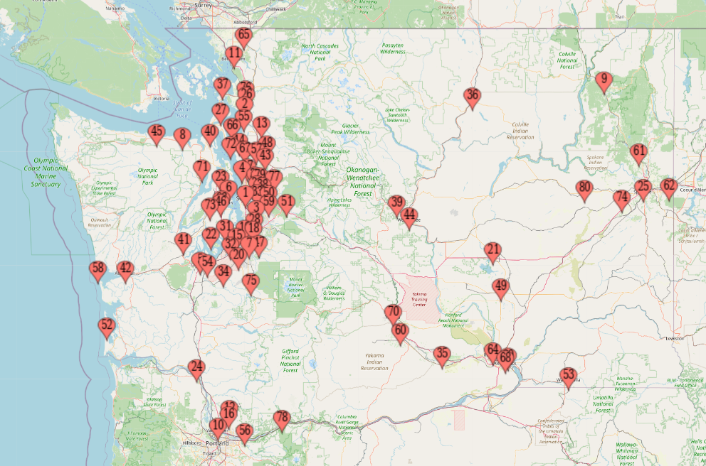
Survey profile
2% responses from 5 countries:
Canada (4)
Mexico (2)
Thailand (1)
Bermuda (1)
Belarus (1)
98% responses from 18 states.
The top three states are:
Washington (84.7%)
Oregon (5.6%)
California (2.8%)
In Washington, responses came from 80 locations.

Slide 4
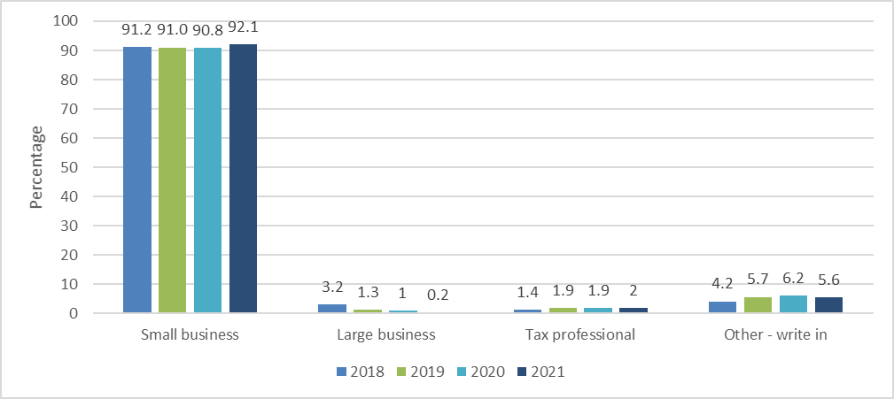
How would you describe yourself or your business?
Respondent perception
2021
+1.3
+0.2
+0.1
-0.6
Notes:
The percentage of respondents who described themselves as a small business increased slightly by 1.3 percentage points.
The percentage of respondents who described themselves as a large business stayed about the same at 0.2%. This is the smallest percentage of respondents that have classified themselves as a large business in the last four years of the survey.
The tax professional percentage had almost no change in the last 3 years.
There was a slight decrease in the number of respondents who described themselves as ‘Other’ from the previous year. The write-in explanations from respondents who selected ‘Other’ were categorized into the following:
Micro-business, self-employed or hobbyist.
Retired.
Non-profit organization or government.
Bookkeeper.

Slide 5
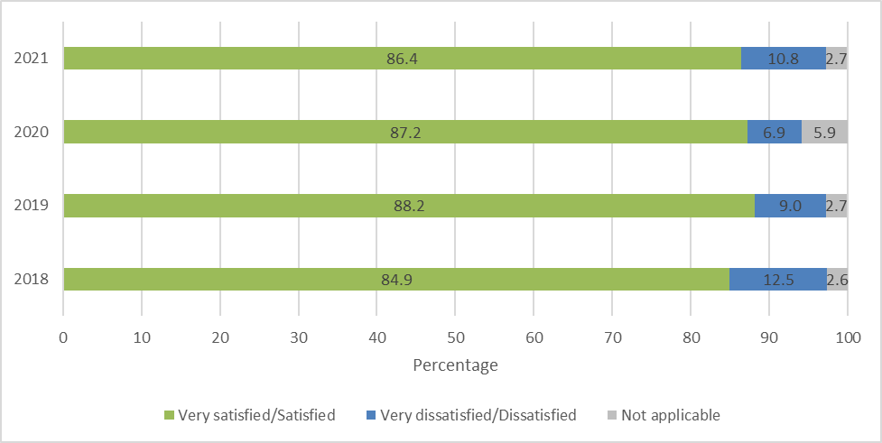
4-year trend
How satisfied were you after your last experience with us?
AVG 86.7
2021
-0.8
3.9
3.2
Notes:
Considering disruption of last two years with pandemic, telework, and closing of all offices – satisfaction remained very consistent.
0.8% decrease from 2020 but still close to average; dissatisfaction overall increased by 3.9%.

Slide 6
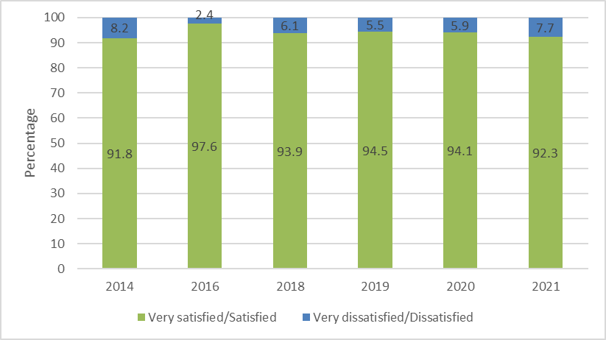
6-year trend
How satisfied are you with the overall quality of service you receive from DOR?
AVG 94.0
2021
-1.8
Notes:
Overall satisfaction decreased slightly by 1.8 percentage points from 94.1% in 2020 to 92.3% very satisfied/satisfied in 2021.
Overall dissatisfaction increased slightly by 1.8 percentage points from 5.9% in 2020 to 7.7% in 2021. This is the highest level of overall dissatisfaction we have seen in this category since 2014.

Slide 7
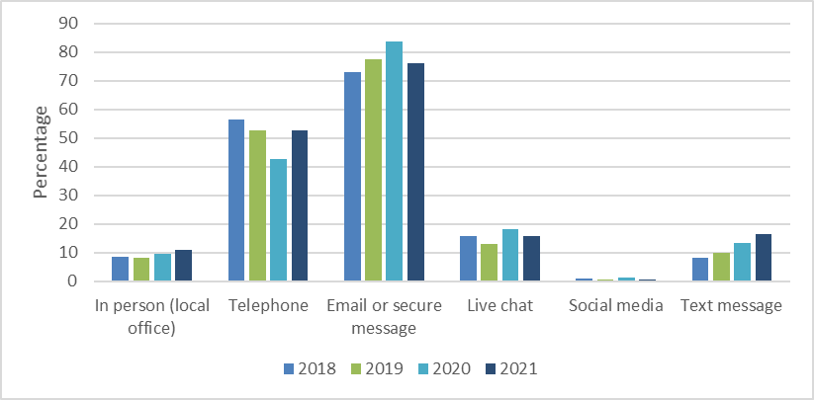
4-year trend
How do you prefer to interact with the Department of Revenue?
(choose all that apply)
2021
1.5
10.2
7.6
2.4
0.5
3.1
Notes:
Telephone increased by 10.2 percentage points in 2021. Telephone remains the second most preferred way to interact with the Department of Revenue since 2018. This is the first time since 2018 that we have seen an increase in telephone being a preferred method of communication. This is likely due to the closures of the DOR front counters for the entirety of 2021.
Email or secure message decreased by 7.6 percentage points in 2021. From 2018 to 2020, it increased by 10.6 percentage points. This year is the first time we have seen a decrease in this category. Majority of respondents prefer to use email or secure message to interact with the Department of Revenue.
Live chat decreased slightly by 2.4 percentage points from 2020 to 2021.
Text message increased 8.3 percentage points since 2018. From 2020 to 2021, it increased by 3.1 percentage points. This preferred method of communication continues to grow steadily each year.
In person increased slightly since 2020 by 1.5 percentage points.
Social media continues to be the least preferred method to interact with the Department of Revenue.

Slide 8
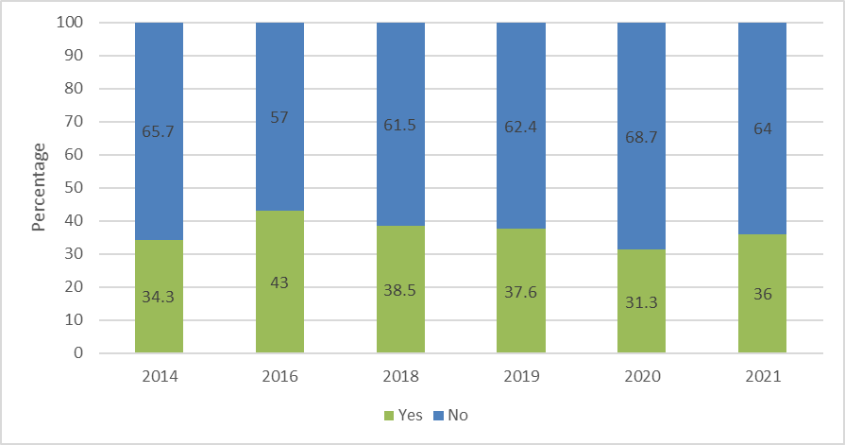
6-year trend
Did you contact our call center during the last year?
AVG 36.8
2021
-4.7
Notes:
In 2021, percentage of customers who had contacted the call center increased by 4.7 percentage points. This is the first time we have seen an increase since 2016. DOR front counters were closed for all of 2021. The need to contact DOR by phone was driven by the negative impact of the pandemic.
Group 2: Two or more business tax accounts 33% vs 50%

Slide 9
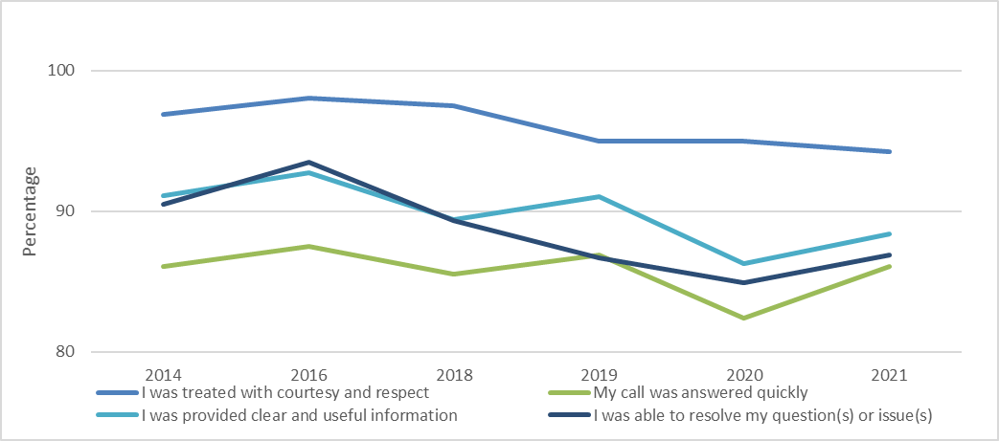
6-year trend
Please tell us about your experience with our call center. (Strongly agree/Agree)
94.2%
88.4%
86.9%
86.1%
2021
I was treated with courtesy and respect
I was provided clear and useful information
My call was answered quickly
I was able to resolve my questions or issues
-0.8
2.1
3.7
2.0
Notes:
I was treated with courtesy and respect strongly agree/agree responses stayed relatively steady at 94.2%.
My call was answered quickly strongly agree/agree responses increased by 3.7 percentage points since 2020.
I was provided clear and useful information strongly agree/agree responses increased by 2.1 percentage points since 2020 but is 4.3 percentage points lower than the highest percentage in 2016.
I was able to resolve my questions(s) or issue(s) strongly agree/agree responses increased by 2.0 percentage points since 2020 but is 6.6 percentage points lower than the highest percentage in 2016.
Overall, there was positive increases in almost every category.

Slide 10
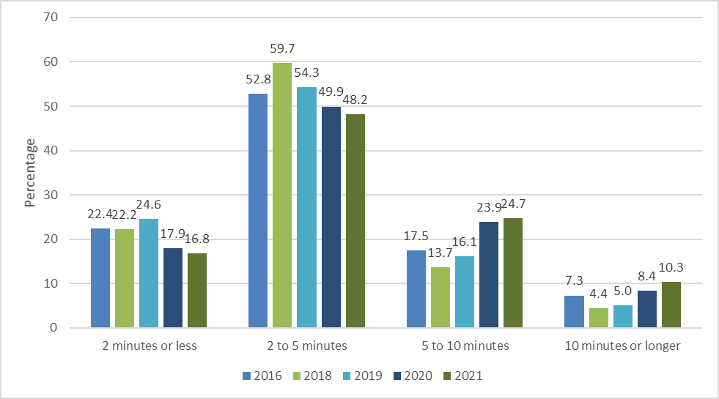
5-year trend
How long are you willing to wait on hold to speak to a customer service representative?
(choose all that apply)?
2021
-1.1
-1.7
0.8
1.9
Notes:
In 2021, some respondents were more willing to wait on hold longer to speak to a customer service representative. Waiting 5 to 10 minutes and 10 minutes or longer combined increased by 2.7 percentage points. These categories have continued to see steady increases since 2018.

Slide 11
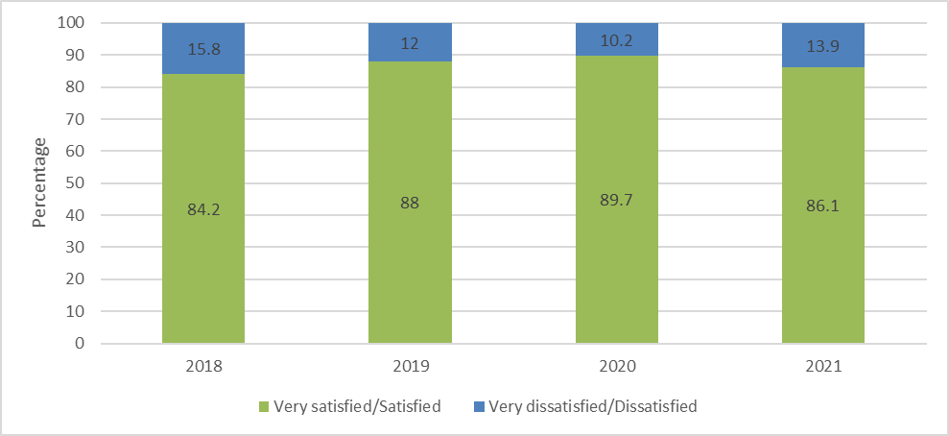
4-year trend
How satisfied are you with our website and My DOR (online filing and payment system)?
AVG 87
2021
3.7
Notes:
In 2021, very satisfied/satisfied responses decreased by 3.6 percentage points from 2020.
MFA launched in September 2021

Slide 12
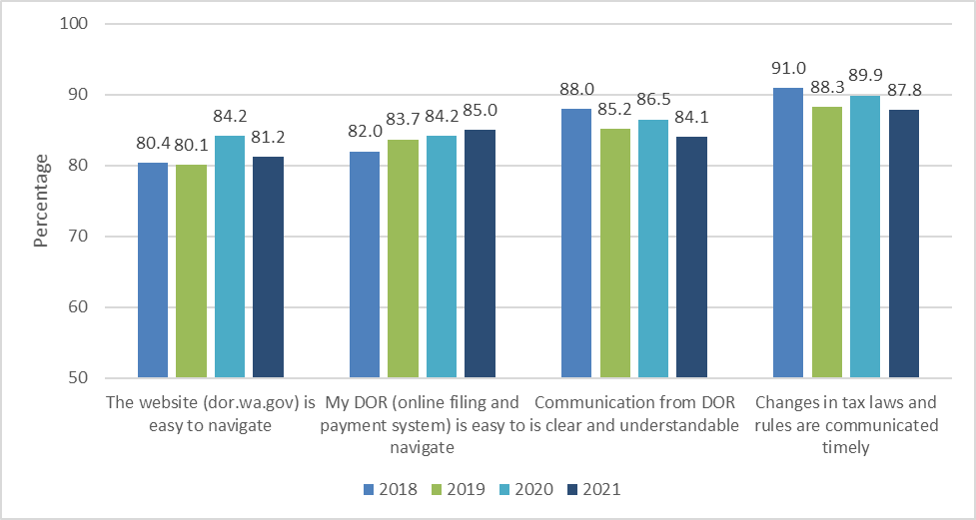
4-year trend
How much do you agree with each of these statements about DOR and its services?
2021
3
0.8
2.4
2.1
Notes:
The website (dor.wa.gov) is easy to navigate strongly agree/agree responses decreased by 3 percentage points since 2020.
My DOR (online filing and payment system) is easy to navigate strongly agree/agree responses stayed about the same in 2021. 2021 had the highest percentage of agreement for this statement since 2018 (when the system went live).
Communication from DOR is clear and understandable strongly agree/agree responses decreased 2.4 percentage points since 2020.
Changes in tax laws and rules are communicated timely strongly agree/agree responses decreased by 2.1 percentage points since 2020.

Slide 13
2021 Strengths
Please tell us what we are doing well.
Answer rate 42%
1
My DOR and the website (78 responses)
Website is easy to use and understand for tax filing.
Quality of customer service (50 comments)
Customer service reps were great! got behind with all the craziness this past year and when I talked with representatives, they were more than helpful and patient. I was having a rough time and really wasn't expecting them to be so nice considering I was delinquent at the time.
Communications including filing reminders, letters, and sales tax change notifications (30 comments)
Email notice alerted me I needed to do my annual filing.
2
3

Slide 14
2021 Critical Satisfier Themes
What is the one thing we should never stop doing?
Answer rate 37%
1
Excellent customer service with live person (53 comments)
Everyone at WA DOR with whom I have spoken on the phone over the years has been knowledgeable and patient. It is very much appreciated.
Communications (35 comments)
Keep making it simpler. Keep using common language instead of legalese.
Offering and improving our online services (22 comments)
Never stop making improvements to the website! It seems that you improved the log in experience a while ago, because I remember that I used to have more trouble with that and needed to reset password.
2
3

Slide 15
2021 Opportunity Themes
Please tell us how we can improve our service to you.
Answer rate 42%
1
Doing well/keep doing what you are doing (50 comments)
There doesn't need to be any changes. I can do my taxes easily on here and it has helped me learn how to do my taxes.
Improving My DOR (33 comments)
I'm not really happy with this "additional" step to sign into my SAW account. Having to have an additional step, sending a code before logging in is a pain!
Training and additional help (19 comments)
Consider design improvements for filing the annual taxes. Could be more like Turbo-tax where you fill out one simple question at a time and get suggestions for help.
2
3
Notes:
Big dissatisfiers with account access and MFA – from multiple sources (call center data, CX Survey data)
Workgroup (Cross agency – LNI, DOL, ESD) working with WaTech on immediate enhancements and long-term solutions and requirements.
My DOR User group meets bi-weekly, cross-divisional workgroup, reviews language, customer experience, and other enhancements
Video projects

Slide 16
Questions?

