Slide 1
Emerging Digital Tax Issues
NFTs and digital currencies
Brent Madison & Nikki Bizzarri, June 13, 2022
This presentation is intended solely for discussion purposes and should not be relied upon as tax advice or to otherwise determine the taxability, exemption, or tax treatment of any specific taxpayer or transaction. To obtain Department advice that you may rely upon, you may request a binding letter ruling from the Department: https://dor.wa.gov/contact/request-tax-ruling.

Slide 2
Overview
What is a blockchain?
Overview of blockchain platforms
World of blockchain platform uses (tokens, currencies, applications)
Non-fungible tokens (NFTs)
Current tax issues
Guidance
Notes:
Good afternoon, thank you for the opportunity to present to you today
Our hope is through this brief presentation that you will be more conversant in emerging digital issues, specifically NFTs and digital currencies
Give you an overview of how these transactions should be taxed
Issues we are running into with taxing
End with an update on forthcoming guidance

Slide 3
What is a blockchain?
A digital ledger of transactions that is duplicated and distributed across an entire network of computing systems comprising the blockchain.
As transactions are proposed to the network they are grouped into “blocks” for verification.
Each block is proposed to the network of computing system participants who either agree or disagree that the block is valid.
Once the network reaches consensus, the block of transactions is recorded and added to the chain of existing blocks.
A copy of the chain is stored on each computing system within the network.
As each new block is added to the existing chain, the integrity of all previously blocks within the chain are effectively re-confirmed by the entire network.
Notes:
By using a decentralized network of computing systems to verify, record, and distribute transactions, rather than a centralized database of transactional records, the system creates a foundation of immutable ledgers.
This foundation provides the framework for individuals, businesses, and other organizations (across the globe) to participate in a variety of transactional activities with one another without the need for third-party arbiters, recordkeepers, regulators, and the like.
RE as each new block is added to the existing chain
This feature of a blockchain makes it nearly impossible for one participant in the network to alter the existing data in the chain, as all the other participants are working on a separate “agreed upon” copy of the chain each time a new block is proposed.

Slide 4
What are blockchain platforms/networks?
Blockchain systems allow people to develop and host applications within the blockchain.
Ethereum is an example of a blockchain platform.
Ether is the native digital currency that is mined, held, exchanged, and used within the Ethereum blockchain network.
Other examples of platforms include: Stellar, IBM Blockchain, Ripple, and Quorum (JP Morgan).
Notes:
Within the Ethereum network, users can create decentralized applications, store data, execute smart contracts, and exchange currencies.

Slide 5
What are blockchain networks used for?
Payment currencies
Used to buy and sell goods or services. Work like FIAT currency
Payment currencies represent the first generation of blockchain technology put to practical use
Examples: Bitcoin, Iota, Dash, ZCash
Stable coins (algorithmic vs. collateralized)
Value is kept equal (or nearly equal) to the value of another asset, such as FIAT currency, precious metals, or stable assets (e.g., barrel of crude oil)
Most stable coins are collateralized, each time a new coin is issued into circulation, the coin is backed by collateral which is put into reserve
Example: USD Coin
Algorithmic stable coins are less common than collateralized ones.
Example: terraUSD (UST)
Notes:
TERRA Example. Was supposed to maintain a 1-to-1 ratio with the U.S. dollar via an algorithmic relationship with Terra’s native currency, the LUNA. If the LUNA price rises, smart contracts issue new USTs sufficient to counter the price rise and maintain a 1-to-1 U.S. dollar conversion rate. If the price drops, USTs are burned.

Slide 6
What are blockchain networks used for?
Security coins
Created as investment instruments
Security coins are those that pass the Howey Test
Security coins are typically issued when a project executes an Initial Coin Offering (ICO)
Utility tokens
A digital token of cryptocurrency that is issued to fund development of the cryptocurrency and that can be later used to purchase a good or service offered by the issuer of the cryptocurrency
Typically issued when a project executes an Initial Coin Offering (ICO)
Non-Fungible Tokens (NFTs)
Notes:
Security Coins
When the issuing company realizes a profit in the market, security coin holders receive a dividend, in the form of additional coins
Utility tokens.
Commonly, a new cryptocurrency ecosystem may offer utility tokens for purchase in order to raise capital which will be used to further develop the ecosystem’s purpose and function (e.g., social networking, consumer reviews, reducing carbon emissions).
Utility tokens are often sold at discounted prices. While utility tokens may be exchangeable for a good or service, many times they can also be sold or exchanged on a secondary market. This aspect makes it difficult to characterize the true nature and function of a utility token, because it frequently depends upon the objective of the token holder.

Slide 7
What are blockchain networks used for?
Decentralized apps (DApps).
Digital applications that run on a blockchain network rather than a single computer or local network of computers.
Decentralization means the application cannot be controlled or interfered with by a single authority.
An example is Chainlink.
Widespread applications.
Healthcare.
Managing medical records, protecting healthcare data, tracking diseases and infections.
Government.
Securing confidential/personal information and records, voting applications.
Banking and finance.
Processing power, safeguarding information, executing transactions.
Notes:
Chainlink.
When data is fed to and from smart contracts within a blockchain network from a traditional business source (e.g., bank), Chainlink secures the feed between the external system and the smart contract (which doesn’t itself interface with external systems).
The Chainlink App validates transfers using the same type of “consensus mechanism” used by the blockchain.

Slide 8
General classifications of crypto assets

Slide 9
Non-fungible tokens (NFTs)
What are they?
Are they taxable?
Administrative issues

Slide 10
What is an NFT?
Non-fungible tokens vs. fungible token
Blockchain technology
Smart contracts
Marketplaces
Types
Music, visual, video works, video games, tickets to events, and access to restaurants, etc.
OpenSea, Axie Marketplace, Nifty Gateway, etc.
Token= unit of value supported by blockchains
Fungible = able to replace or be replaced by another identical item (e.g., ten-dollar bill)
Non-fungible = unique and irreplaceable one-of-a-kind asset
Non-fungible token = digital record that uniquely associates a work with an owner
Notes:
Example: manufactured versus custom built home

Slide 11
Where and how are the transactions taxed?
What is the underlying product being taxed?
How are the transactions sourced or apportioned?
What are the responsibilities of the parties involved?
Other issues (e.g., bundling, marketplace)

Slide 12
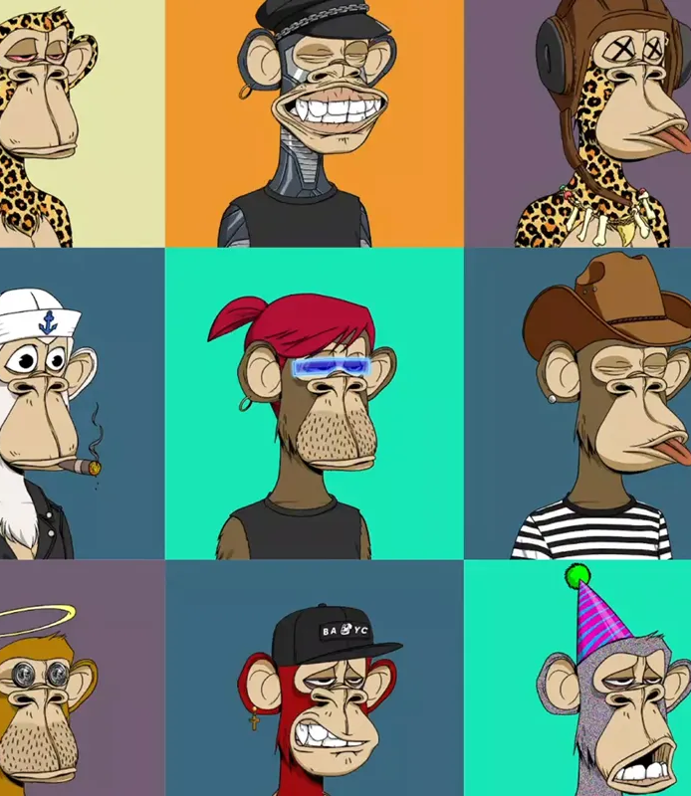
What does a purchaser get when they purchase an NFT?
Digital products
Tangible personal property (e.g., a vintage car)
Real property (e.g., land)
Other (e.g., services, tickets to a sporting event)

Slide 13
How are NFTs taxable in Washington?
Taxation based on the underlying goods or services (i.e., smart contract, delivery, true object of the purchase)
“Digital Code” means a code that provides a purchaser with the right to obtain one or more digital products, if all of the digital products to be obtained through the use of the code have the same sales and use tax treatment. . . A digital code may be obtained by any means, including email or by tangible means regardless of its designation as song code, video code, book code, or some other term. (RCW 82.04.192(5)).
Exemptions? (RCW 82.08.0208)
Notes:
"Digital code" does not include a code that represents a stored monetary value that is deducted from a total as it is used by the purchaser. "Digital code" also does not include a code that represents a redeemable card, gift card, or gift certificate that entitles the holder to select digital products of an indicated cash value.

Slide 14
How are NFTs taxable in Washington?
What if an NFT is a right to obtain the rights to a digital product (e.g., picture or video)?
Subject to retailing B&O and retail sales tax. (RCW 82.04.050(8)(a), 82.04.190, 82.08.020).
What if an NFT includes a right to obtain access to multiple digital goods or services?
Most likely subject to retailing B&O and retail sales tax as a sale of a “digital code”. (RCW 82.04.050(8)(a), 82.04.190, and 82.08.020).
What if an NFT includes both a taxable good and the right to obtain nonretail sales taxable services (e.g., entertainment)?
At least some portion of the sale is likely subject to retailing B&O and retail sales tax, or the entire package as a bundled transaction, depending on the facts and circumstances. (RCW 82.08.190 and 82.08.195(1),(2),(7)).
What if an NFT is a right to obtain a nonretail sales taxable service?
The gross income received is subject to the service and other activities B&O tax. (RCW 82.04.290).
What if an NFT sale requires payment of a royalty to the NFT creator?
The gross income received by the NFT creator is subject to royalties B&O tax. (RCW 82.04.2907).
Notes:
TPP
Real estate

Slide 15
Where are transactions taxed?
Sourcing
Apportionment

Slide 16
Sourcing Retail Sales
Digital products are sourced according to the following hierarchy in RCW 82.32.730:
The seller’s place of business if the purchaser receives the digital product at the seller’s place of business;
If not received at the seller’s place of business, the location where the purchaser receives the digital product,;
If the location where the purchaser receives the digital product is not known, the purchaser’s address available in the seller’s business records;
If no address is available in the seller’s business records, the purchaser’s address obtained at the time of sale (e.g., purchaser’s payment instrument); and
If no address is obtained at the time of sale, the address where the digital product is first made available for transmission by the seller (i.e., the seller’s address).

Slide 17
Gross Income Apportionment
Gross income from apportionable activities is attributed to Washington where the benefit of the service is received. (WAC 458-20-19402).
Apportionable royalty receipts are attributed to Washington according to where the intangible property will be used. (WAC 458-20-19403).

Slide 18
Examples
Throughout, and in the next section of this presentation, the department provides a number of examples that identify facts and then state a conclusion. These examples should be used only as a general guide. The tax results of other situations must be determined separately after a review of all of the facts and circumstances.
To obtain Department advice that you may rely upon, you may request a binding letter ruling from the Department: https://dor.wa.gov/contact/request-tax-ruling.

Slide 19
Example 1 - Sale of an NFT that is a digital good
Tim lives Friday Harbor, Washington. He creates highly coveted puffin NFTs, Peculiar Puffins. Tim sells a one-of-a-kind puffin NFT, which provide ownership of a digital good.
Bill, who resides in Tacoma, Washington, purchases the NFT. Bill first accesses the NFT from his place of residence.
Tim knows that Bill resides in Tacoma, Washington at a specific address.
The sale is subject to retail sales tax and retailing B&O.
While Tim may not know where receipt occurs, the sale is sourced to Tacoma, Washington under RCW 82.32.730(1)(c).
On the sale, Tim must pay B&O tax and collect retail sales tax at the combined state and local rate for Tacoma.
Notes:
This is a simple example, however, we recognize that there are highly complicated sourcing issues where the buyer uses non traceable crypto and their identity is not known to the seller.

Slide 20
Example 2 - Sale of an NFT via marketplace facilitator
Assume the facts from Example 1, except the NFTs are sold on the Bubbles marketplace.
Bubbles, a marketplace facilitator, takes a 1% commission on all NFT sales made on its blockchain marketplace, including the sale of Tim’s Puffin NFTs.
Bubbles is subject to service & other activities B&O tax on sales commissions attributable to Washington, including commissions from the sale of Tim’s NFTs.
Bubbles is also required to collect RST on sales made through its marketplace that are sourced to Washington. (RCW 82.08.052(2)). Bubbles is not subject to retailing B&O tax on the sales facilitated for Tim.
Tim is subject to retailing B&O.

Slide 21
Example 3 - Sale of an NFT where a royalty is retained
Assume the facts from Example 1.
Tim purchased the ownership rights for the Puffin NFT from the creator, Jeannette.
Tim agrees to pay Jeannette a 1% royalty on all subsequent sales of NFTs created by Jeannette.
Jeannette resides in Bellingham, Washington, where she designs and produces digital artworks that become NFTs.
The royalty income is sourced to the location where Bill used the NFT in Washington.
Jeannette is subject to royalties B&O tax on Tim’s sale to Bill through the Bubbles marketplace.

Slide 22
Administrative Issues
Pseudonymous transactions
Federal disclosure requirements
Marketplace obligations
Enforcement

Slide 23
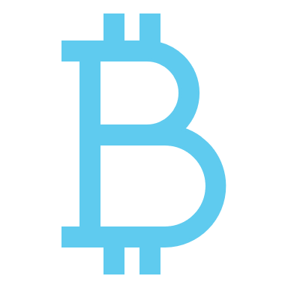
Published Guidance
Interim guidance statement on Bitcoin
Published August 20, 2019
Interim guidance statement on NFTs to get basic information out quickly.
Actively in development
Department plans to adopt formal guidance in the form of an ETA
Anticipated to incorporate the IGS.
Anticipated to be more expansive than the IGS.
Will involve a stakeholder process.
Other Crypto Topics (e.g., other types of coins/tokens, DApps, bundled transactions, marketplace facilitators)
No definitive form or timeline.

Slide 24
Questions? Comments?
Please don’t hesitate to reach out to us after this presentation!
brentonm@dor.wa.gov
nikkib@dor.wa.gov

