Slide 1
Revenue Staffing Team
What we are doing in the “Great Resignation”
Patrick Sutten, Senior Recruiter, Military Liaison
Notes:
Thank you for inviting our team here to share some information with your committee on our recruiting activities here at Revenue.
As you know, recruiting is difficult all over the world and significant enough that it’s named the Great Resignation.
There are several reasons for the massive vacancies and limited applicant pools. Some say it was COVID-19. Some say it was the move to remote work and not wanting to return to the workplace. Some say it is the vaccination mandate. Some say it is just the new generation or the exodus of the Baby Boomer generation. What ever it is, it is not making life easy for any of us that need quality talent.

Slide 2
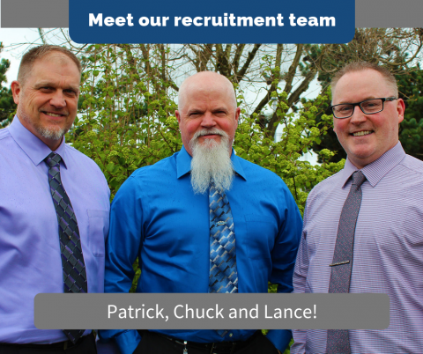
DOR Staffing Team
Chuck Johnson, TARM - 14 years of recruiting experience with the State of WA. Retired military.
Patrick Sutten, Sr Recruiter - 20+ years of recruiting experience, both military and State of WA. Retired military.
Lance Proctor, Sr Recruiter – 5 years of recruiting experience with State of WA, 20 years of State employment experience.
Notes:
Our staffing team consists of a close-knit team of three. Chuck and I are both retired military and I am the dedicated military liaison. Lance may only have 5 or so years of experience as a recruiter, but he has 20 years with the agency, has worked in several different job classes, including an Administrative Assistant for two different divisions. Lance knows this agency very well and is our dedicated diversity recruiter.

Slide 3
Current Recruitments
State of WA currently has between 1800 – 2000 open recruitments.
DOR currently maintains 20-40 open recruitments.
DOR posting an average of 10 new jobs per week.
Notes:
In previous years, the state has normally had between 300 and 800 jobs open on a regular basis. Prior to 2021, we normally had 6-9 open recruitments regularly here at Revenue. As you can see, the numbers have increased significantly.

Slide 4
Numbers for 2022
DOR authorized FTE count is: 1379
Total Number of Permanent Employees: 1222
YTD Total Employees Who Left DOR: 132
YTD Employees Who Left State Service: 99
Notes:
As you can see, we have about 150 vacant positions. We are also losing more employees than any year in recent history. Of the 132 that have left us, only 11 of those are retirements. Leaving for other state agencies used to be where we lost the majority of our separations. Now the majority are leaving state service altogether.

Slide 5
Comparisons
Year by Year Volume Progression
2018 we conducted 213 Recruitments
2019 we conducted 215 Recruitments
2020 we conducted 104 Recruitments*
2021 we conducted 314 Recruitments
2022 We are conducting 40 Recruitments per month, and expect to complete ~484 Recruitments
*hiring freeze for partial year
Notes:
From these numbers, you can see that we are currently on track to open almost as many recruitments this year as we had in 2018, 19 and 20 combined.

Slide 6
Applicant Pool Comparisons
Total Applications: 5845 Total Certified: 2734 46%
Total Applications: 5001 Total Certified: 2511 50%
Total Applications: 2718 Total Certified: 1281 47%
Total Applications: 4805 Total Certified: 2623 54%
Estimated Applications: 5635 Est. Certified: 3634 65%
Notes:
Up until this year, our average percentage of referred candidates has been about 50% of our applicant pools.
From the looks of it, this year is will be around 65%.
This sounds like it would be great news, but it isn’t.
We are finding is that of those certified, many just do not have the:
knowledge, skills and abilities to start in the position,
or they are declining the offer due to other offers,
the lack of fulltime telework options,
the COVID-19 vaccine mandate,
or we are just losing out to other, faster and more lucrative offers.
But most significantly, our recruitments, as you saw from the previous slide, have more than doubled, therefore we are seeing less than half the number of applicants as we have seen previously.
And as you will see from our next slide, the number of failed recruitments has skyrocketed.

Slide 7
Reposted Recruitments (due to failure to hire)
Reposted Recruitments: 2
Reposted Recruitments: 0
Reposted Recruitments: 31
Reposted Recruitments: 37 (5 months)
Notes:
Last year and this year have been very difficult years to fill positions.
This thing they are calling the Great Resignation has been difficult on everyone.
Last year we had to fail and re-open 31 recruitments and have already surpassed that in the first 5 months of this year.
This is a new phenomenon for us.
The quality of applicants and the low response rate is mostly to blame.
This appears to affect our IT jobs and the more senior professional and technical positions.

Slide 8
What Are We Doing to Beat the Great Resignation?
Announcements Updated
BLUF
New Graphics
Personalize
Accessibility
Reduce/Change/Update Quals
Include links to video & loan student loan forgiveness
Notes:
We are doing a lot to help overcome the dismal numbers and responses that we are getting.
The first thing we did was to give our job announcements a makeover:
Since most of the job sites that scrape our jobs from Careers.wa.gov only use the first paragraph, we have put the Bottom Line Up Front (BLUF).
We worked with Communications and Customer Experience division on some new and exciting graphics as well as worked with the CEC accessibility expert on making our announcements more accessible to people of all life circumstances.
We have also personalized our announcements with a photo and blurb from the recruiter.
This has really opened a line of communication with our applicants (no other state agency is doing this).
We are also working with divisions on reducing, changing and updating the minimum qualifications so the jobs are more attractive.
We have asked the divisions to review their requirements to include only the requirements that the candidates must have, not all the nice-to-have qualifications.
And the last thing that we have done to improve our announcements is to include a compelling paragraph that tells how wonderful the agency is to work for and it includes a link to our new recruitment video and a link to the Student Loan Forgiveness website.

Slide 9
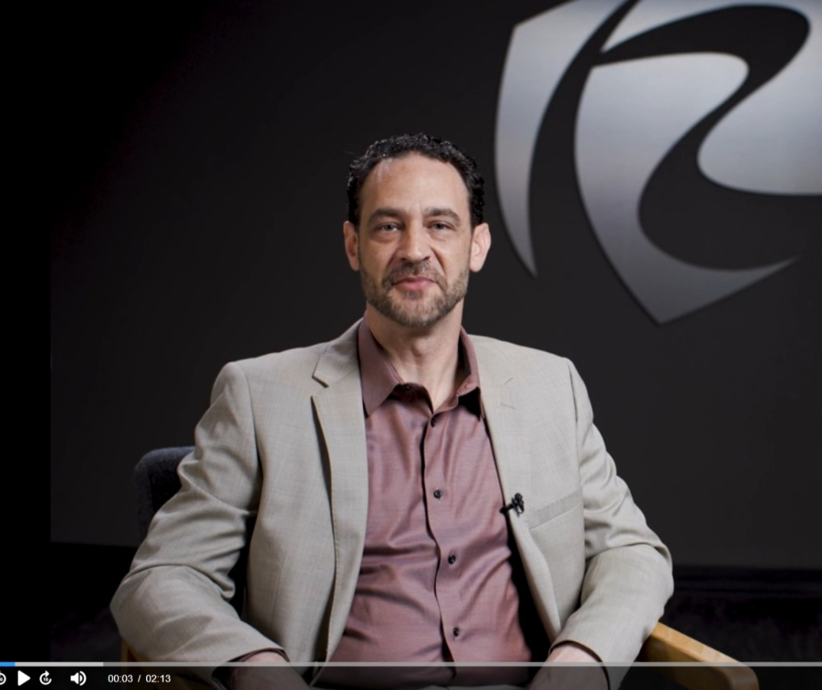
What Are We Doing to Beat the Great Resignation?
Recruitment Video
Link in postings
Link on Jobs page
Linked to Social Media
Notes:
Speaking of the recruitment video.
We worked with CEC to develop a 2 minute recruitment video that showcases DOR as an employer of choice.
The video has garnered much attention and is even up for an award with the Federal Tax Administration.
Like I said, we include a link in our announcements, include a link on our careers page of DOR.wa.gov and we link it to our social media pages.
The feedback has been overwhelming and includes several new employees that stated it is the reason they applied to work at Revenue.

Slide 10
What Are We Doing to Beat the Great Resignation?
Career Fairs
Handshake
Statewide BRG’s/state agencies
Social media (FB, LinkedIn, Twitter)
Paid job sites
Notes:
We also attend career fairs around the state.
Most of these are either sponsored by higher education institutions or sponsored by the military installations.
We post all of our jobs requiring degrees to Handshake (explain if necessary) and we share with the statewide business resource groups and state agency contacts at the Department of Vocational Rehabilitation, School of the Blind and etc.
With the assistance of CEC, we post our jobs on social media platforms as well.
Finally, for our more difficult to fill positions we utilize paid job sites.
An example would be the Washington Bar Association job board for our positions requiring a law degree or the Congress of the American Indian for our Tribal associated jobs.

Slide 11
What Are We Doing to Beat the Great Resignation?
Mitigating Implicit Bias in the Hiring Process Course.
Hire Right Guide
New Supervisor Orientation
Post our new jobs weekly on ReveNews
Notes:
We have developed a course entitled Mitigating Implicit Bias in the Hiring Process that is required for all recruiters, hiring managers and interview panelists.
This 3 hour course explains what Implicit Bias is, how to recognize it, and provides strategies and methods to mitigate bias in the hiring process so that we may better diversify our hiring.
We also provide all our hiring managers with a dedicated hiring process that includes a Hire Right guide so that we may be most effective in conducting quality and defensible recruitments.
Then during our quarterly New Supervisor Orientation, we provide a one-hour overview of the recruitment process with hiring managers in mind. Once complete, every new supervisor understands where all the tools and resources are in order to start, conduct and complete the hiring process.
We encourage all our employees to refer quality prospects to Revenue. Every employee is a representative and therefore a recruiter for our organization. 1200 recruiters are certainly better than three.
Finally, we post our new opportunities in our agency intranet news source, ReveNews, every Monday.

Slide 12
Questions???
Notes:
I hope this information was helpful. This is all I have for you today, unless you have questions. I would also like to hear any ideas that you may have for activities that we are not doing that is working for you.

